Slide 1

ELK 監測 Kubernetes 應用
David Chang
DevOps@mithril

Slide 2

第一次ELK就上手
https://github.com/chechiachang/elk-kubernetes
Notes:
放 ELK有什麼優勢

Slide 3
What is ELK Stack?

Slide 4

3 open source projects
Kibana 分析和可視化平台
Elasticsearch 分布式全文搜索引擎
Logstash 數據收集和日誌解析引擎
Beats lightweight data shippers
Notes:
Focus more on Kibana and Logstash 不必有全文搜索的專業知識，便可使用分析搜尋

Slide 5
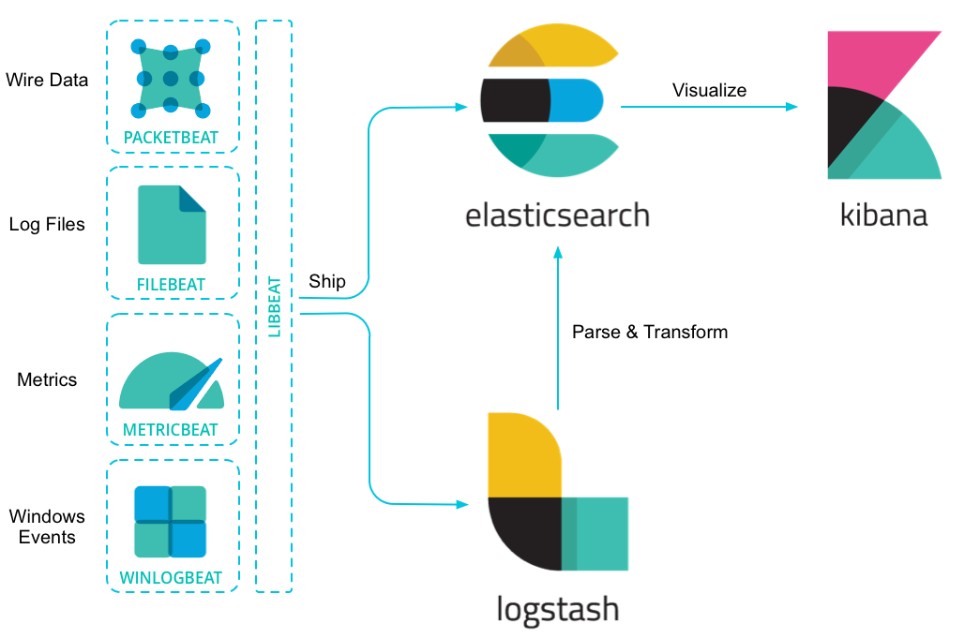

Slide 6
Why ELK
為何要收 Log / Metrics？放DB 不好嗎？
Notes:
放 ELK有什麼優勢

Slide 7
Why Collect log
Why log exists?
Debug with your log
Debug ahead of your error ML?
Notes:
Engineer don’t log weather chats or dirty jokes. Those are diary of your application.

Slide 8
System logs
System logs SSH access, events, stress…
Access log (Nginx)
Notes:
http://ita.ee.lbl.gov/html/contrib/NASA-HTTP.html

Slide 9
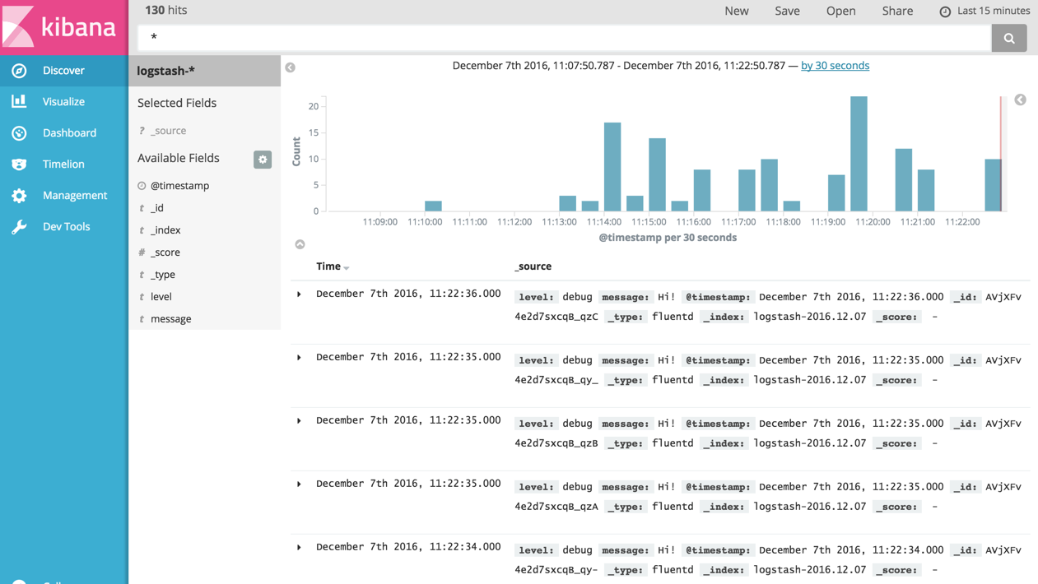
Logs
Diary of your application

Slide 10
Metrics
System Metrics CPU / Memory / storage / IO
App Metrics resource usage / performance
Notes:
http://ita.ee.lbl.gov/html/contrib/NASA-HTTP.html

Slide 11
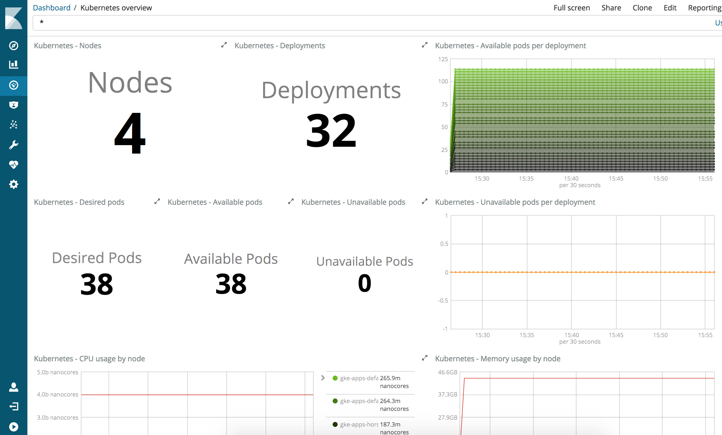
Metrics
How well your apps are

Slide 12
Kubernetes
Things always get a little complicated on Kubernetes ;)

Slide 13

Kubernetes logging
https://kubernetes.io/docs/concepts/cluster-administration/logging
Log of container runtime
Cluster-level logging
Make sure your k8s store log
Notes:
docker log / podman log GKE -> stackdriver Make sure your k8s store log

Slide 14
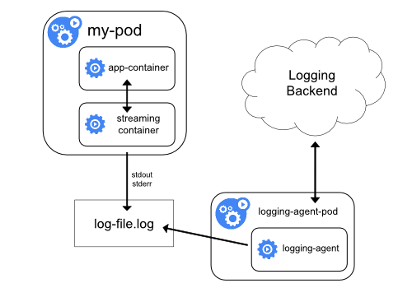
One Pod, kubectl logs :)
App generates log
Container runtime strout
Log file visible on Node
Apply a collector
Mount log

Slide 15
1000 pods, have fun :P
Hard to locate error pod / log
Terminated pod don’t log
microservices, components
Third party services, nginx, kafka, redis…
Multi-clusters
Notes:
水平拓展

Slide 16
Alternatives(?) to ELK
Datadog
Stackdriver for GCP
Prometheus / Grafana
Fluentd
弄清楚你的需求

Slide 17
第一次ELK就上手
雷都踩過了...
Notes:
放 ELK有什麼優勢

Slide 18
Quick Start ELK
Have a Elasticsearch + Kibana
Config / Deploy beats to your apps / nodes
Create index pattern on kibana
Add visualization
Notes:
錢能解決就不要用人解決

Slide 19
Have a Elasticsearch + Kibana
Elastic Cloud (Saas) No deployment, configuration, or cluster maitainance
Self-hosted open source ELK no authentication
Notes:
錢能解決就不要用人解決

Slide 20
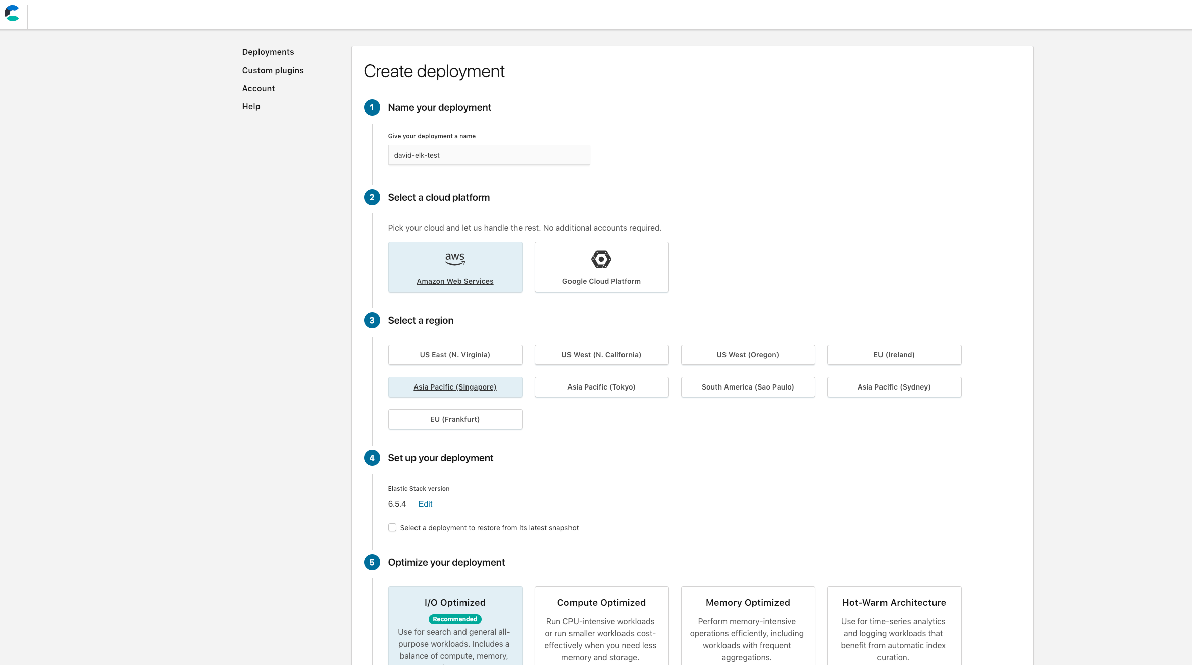
Create Deployment

Slide 21
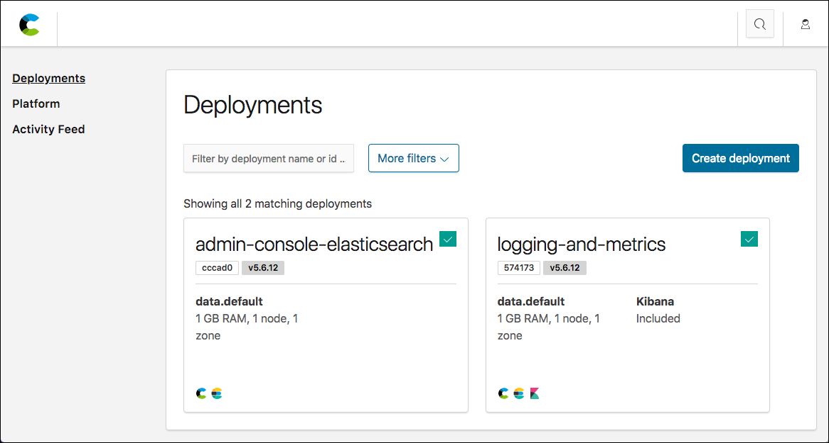
Elastic Cloud
Elasticsearch cluster + kibana node

Slide 22
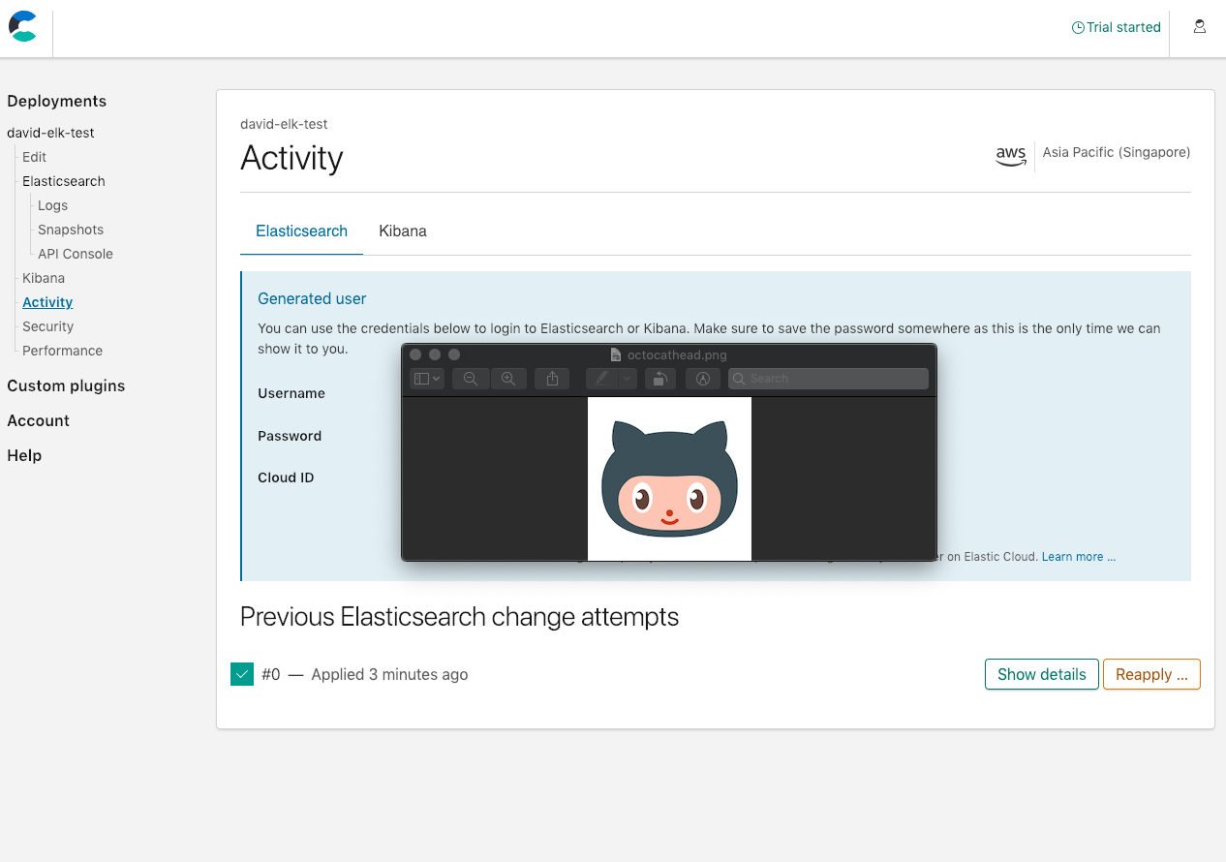
Get id and auth

Slide 23
Deploy beats

Slide 24
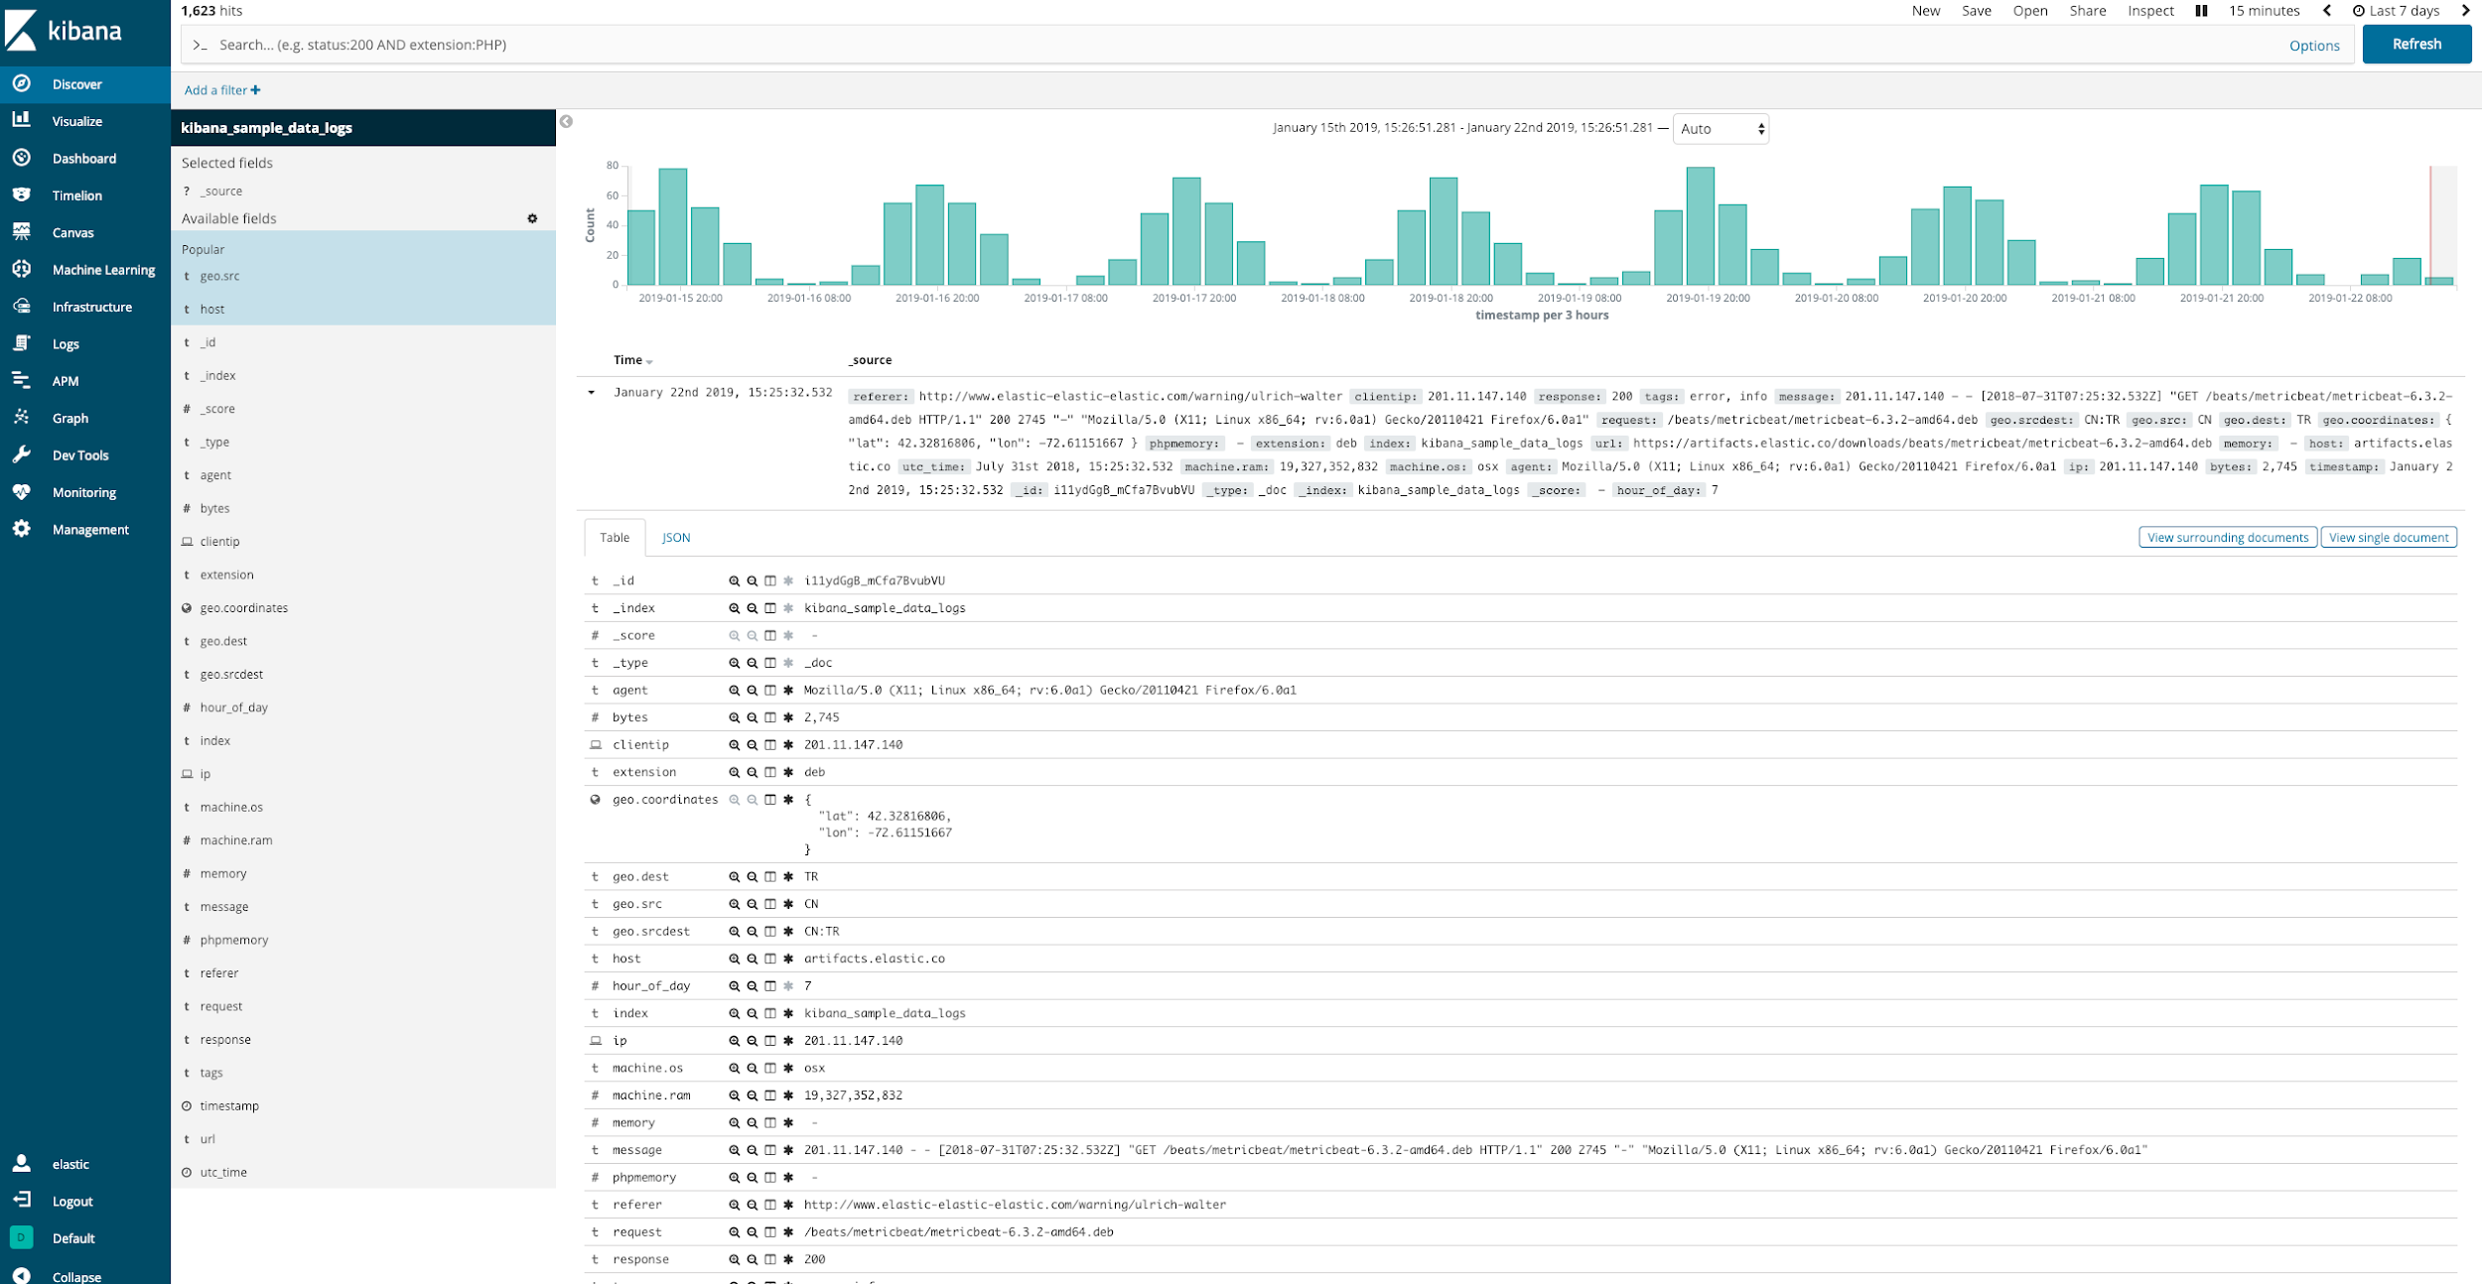

Slide 25
Beats config
Elasticsearch authentication
Where’s log
Use module: system, nginx, docker
beat-side data digestion
Notes:
Slow: type assertion, parse, execute, requires lots of optimization

Slide 26
Logstash pipeline (for nginx)
How to parse nginx log
pattern match
Reduce raw data
Normalize log to basic type
Minimize index size
Tidying up your log
Notes:
Log everythingtidying up

Slide 27
35.185.145.221 - [35.185.145.221] - - [26/Dec/2018:10:44:22 +0000] "GET /modules/actions/api?timestamp=1545821062&hash=e63ffc17319baa5524a7ad10dbb3c4be822c4e519d88efdae511116498d6c9e2 HTTP/1.1" 200 3 "-" "python-requests/2.18.4" 416 0.013 [default-app-server-80] 10.24.10.14:8080 3 0.014 200 67ce5290d19e39b2a6b614a617a1cd98

Slide 28
ELKB for complex data
Logstash pipeline: inputs → filters → outputs
beat
logstash
Elasticsearch
Kinana
Chart Data Source Info

Slide 29
https://raw.githubusercontent.com/chechiachang/elk-kubernetes/master/logstash/pipelines-configmap.yaml input { beats { # The lisening port of logstash port => 5044 host => "0.0.0.0" } } filter { # Nginx-ingress controller example if [kubernetes][container][name] == "nginx-ingress-controller" { …… } } # filter output { elasticsearch { hosts => ["https://${ELASTICSEARCH_HOST}:${ELASTICSEARCH_PORT}"] user => "${ELASTICSEARCH_USERNAME}" password => "${ELASTICSEARCH_PASSWORD}" index => "%{[@metadata][beat]}-%{[@metadata][version]}-%{+YYYY.MM.dd}" manage_template => false } }

Slide 30
filter { # Nginx-ingress controller example if [kubernetes][container][name] == "nginx-ingress-controller" { # Parse message with grok grok { match => { "message" => “...” } #remove_field => "message"} mutate { add_field => { "read_timestamp" => "%{@timestamp}" }} date { match => [ "[nginx][access][time]", "dd/MMM/YYYY:H:m:s Z" ] remove_field => "[nginx][access][time]" } kv { source => "[nginx][access][url_params]" field_split => "&" } useragent { source => "[nginx][access][agent]" target => "[nginx][access][user_agent]" remove_field => "[nginx][access][agent]" } geoip { source => "[nginx][access][remote_ip]" target => "[nginx][access][geoip]" #fields => ["country_name","city_name","real_region_name","latitude","longitude","ip","location"] }

Slide 31
35.185.145.221 - [35.185.145.221] - - [26/Dec/2018:10:44:22 +0000] "GET /modules/actions/api?timestamp=1545821062&hash=e63ffc17319baa5524a7ad10dbb3c4be822c4e519d88efdae511116498d6c9e2 HTTP/1.1" 200 3 "-" "python-requests/2.18.4" 416 0.013 [default-app-server-80] 10.24.10.14:8080 3 0.014 200 67ce5290d19e39b2a6b614a617a1cd98
%{IPORHOST:[nginx][access][remote_ip]} - \[%{IPORHOST:[nginx][access][remote_ip_list]}\] - %{DATA:[nginx][access][user_name]} \[%{HTTPDATE:[nginx][access][time_local]}\] \"%{WORD:[nginx][access][method]} %{DATA:[nginx][access][url]} HTTP/%{NUMBER:[nginx][access][http_version]}\" %{NUMBER:[nginx][access][response_code]} %{NUMBER:[nginx][access][body_sent][bytes]} \"%{DATA:[nginx][access][referrer]}\" \"%{DATA:[nginx][access][user_agent_original]}\" %{NUMBER:[nginx][access][request_length]} %{NUMBER:[nginx][access][request_time]} \[%{DATA:[nginx][access][proxy_upstream_name]}\] %{DATA:[nginx][access][upstream_addr]} %{NUMBER:[nginx][access][upstream_response_length]} %{NUMBER:[nginx][access][upstream_response_time]} %{NUMBER:[nginx][access][upstream_status]} %{DATA:[nginx][access][req_id]}

Slide 32
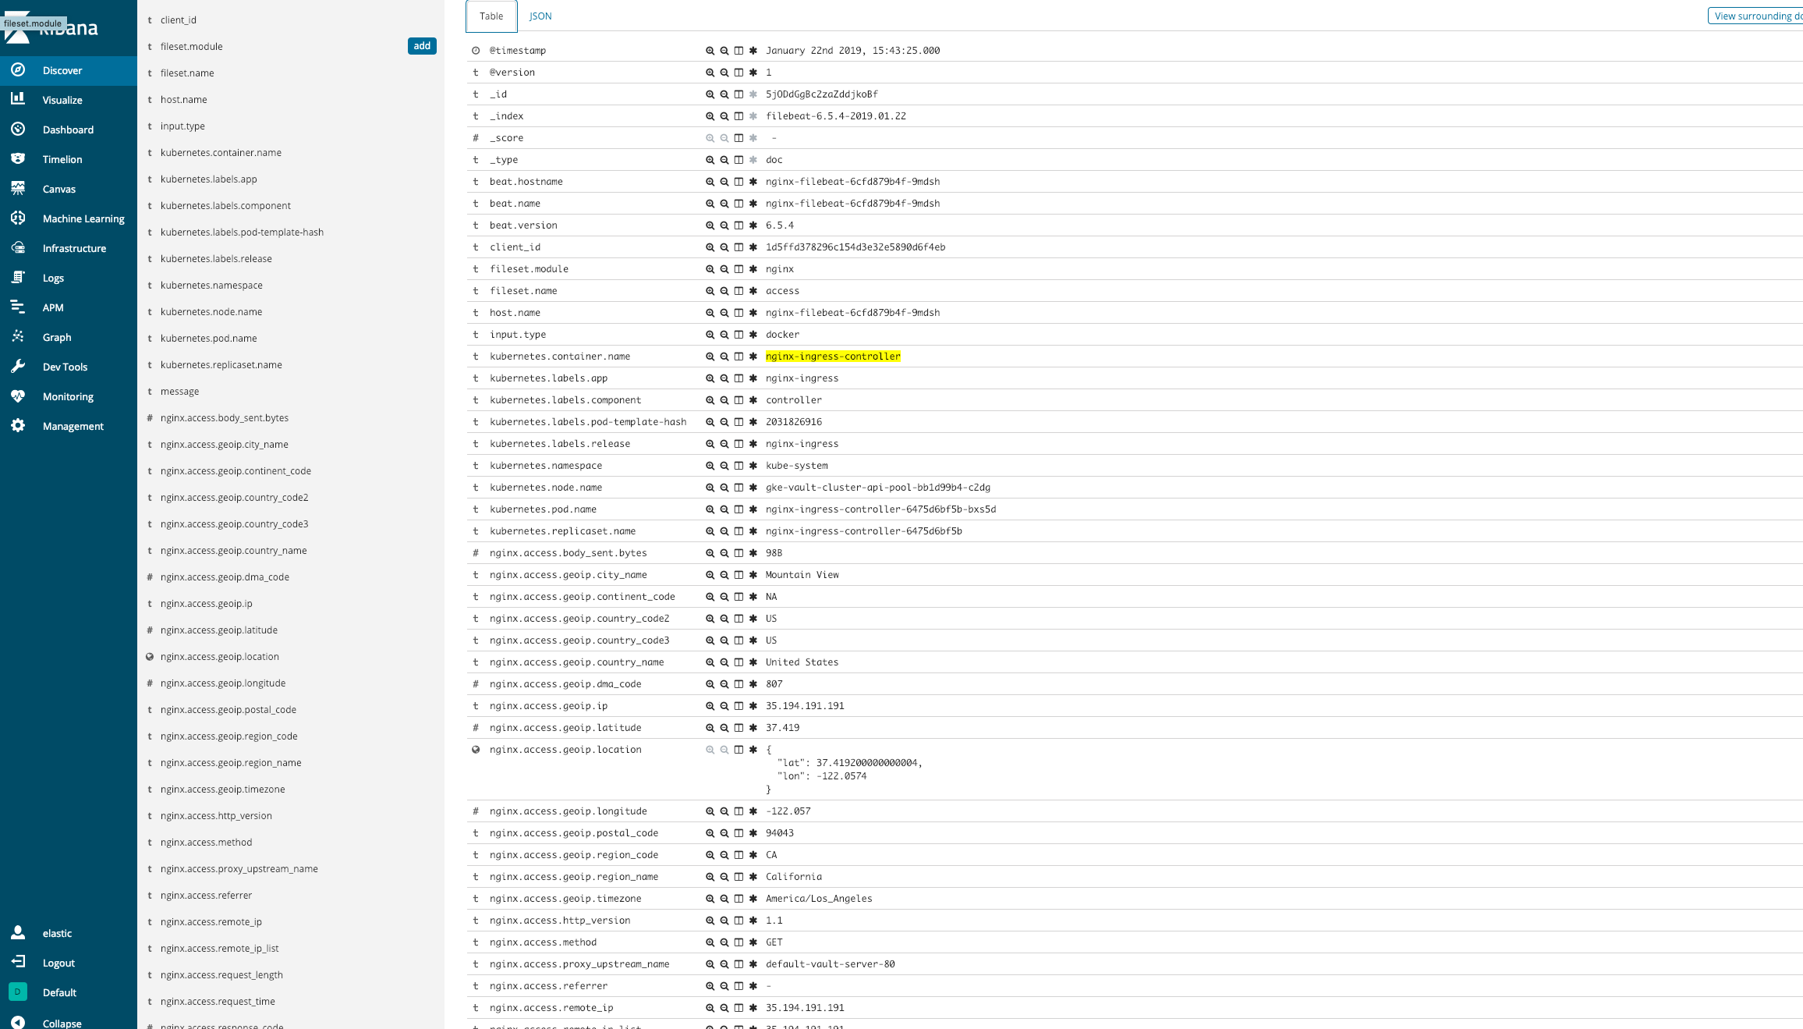

Slide 33
Real Use Cases

Slide 34
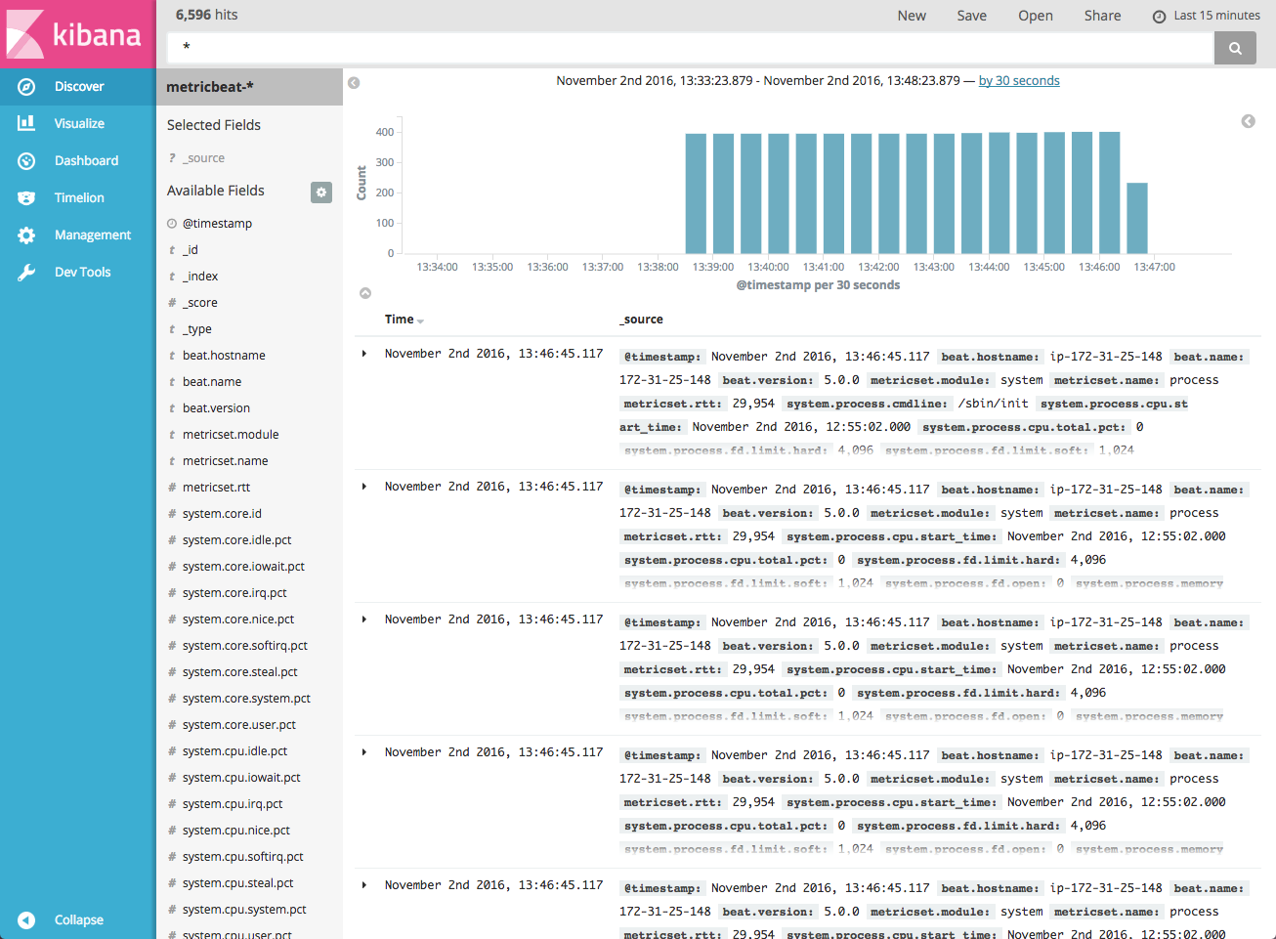
System Metrics

Slide 35
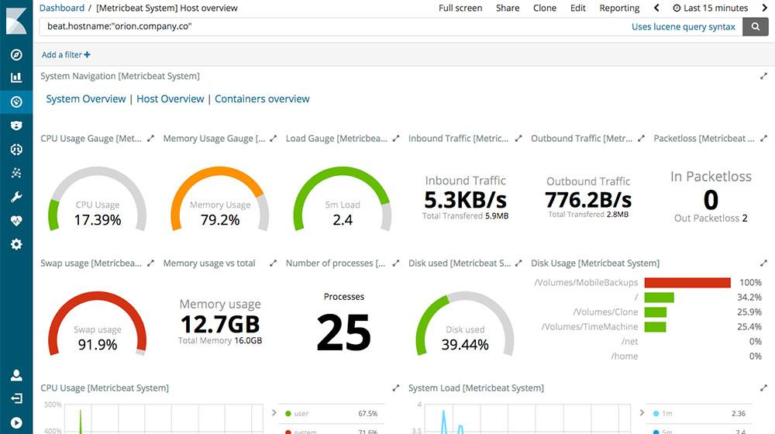
System Metric Dashboard

Slide 36
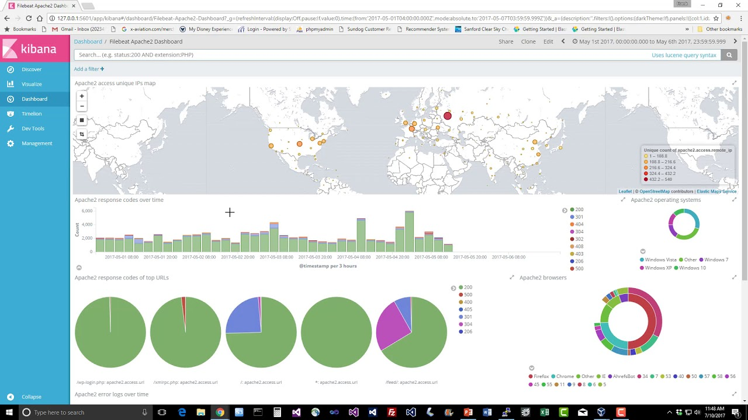
Kibana Nginx Dashboard

Slide 37
Log 放 DB 不好嗎?
資料讀取的方便性
Data Define Language
分析工具
Elastic Data Storage
full-text search
visualization
Notes:
ELK pros cons

Slide 38
導入ELK心路歷程
Datadog, Stackdriver,...
訂立需求
收集所有資料
釐清需求 <-> 整理資料
穩定需求與pipeline
產生視覺化報表
提供資料 / 告警給團隊
Notes:
Modeling

Slide 39
ELK pros & cons
lightweight collector
powerful data pipeline
elastic data write
complex search and query
Analysis tools & Visulization
Storage consuming
Not for permanant
Notes:
Modeling

Slide 40
Q&A

